Slide 1
Rook
Rephrase your science book

Slide 2
What inspired the idea?
A lot of learners, who are students, teachers, elder people, are unable to fully understand a book that is in a language that they know(can be fluent in it or can be their second language) due to the complexity of a certain type of science book.
Rook is an application that can simplify the text from the book, rephrasing it to a more simple form of wording, vocabulary, structures, syntax, depending on the users’ level of the language.

Slide 3
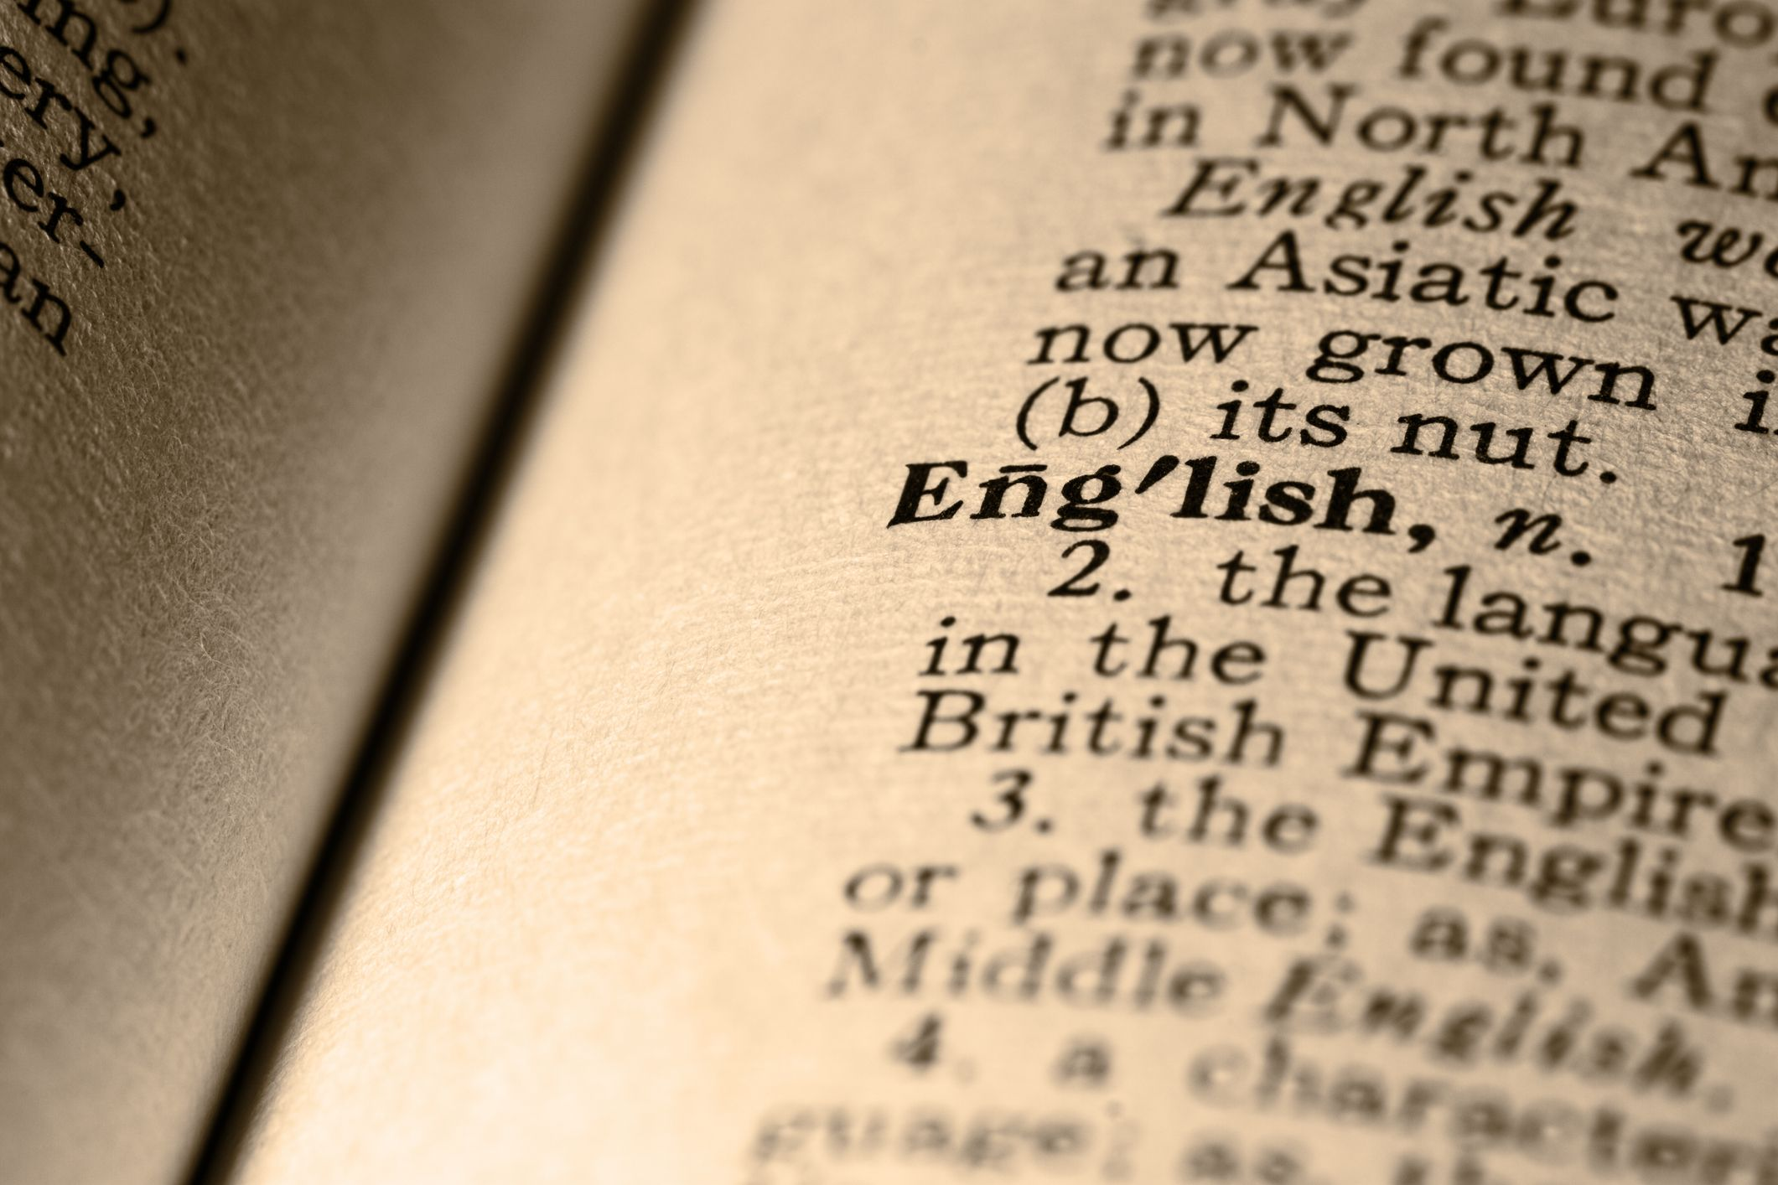
How does Rook do it in general?
First, Rook gets the data from the user about their level of a certain language.
Then, Rook gives the user a test to thoroughly assess their understanding in the language.
After that, Rook uses the AI software to rephrase the book to a more simple text that is compatible to users’ level of the language

Slide 4


Who will benefit from Rook and what are the benefits?
- Everyone who has needs in reading a book will benefit from Rook.
- Learners(students, teachers,…) are now able to comprehend the knowledge of science book more easily.
- Expand their knowledge in science.

Slide 5
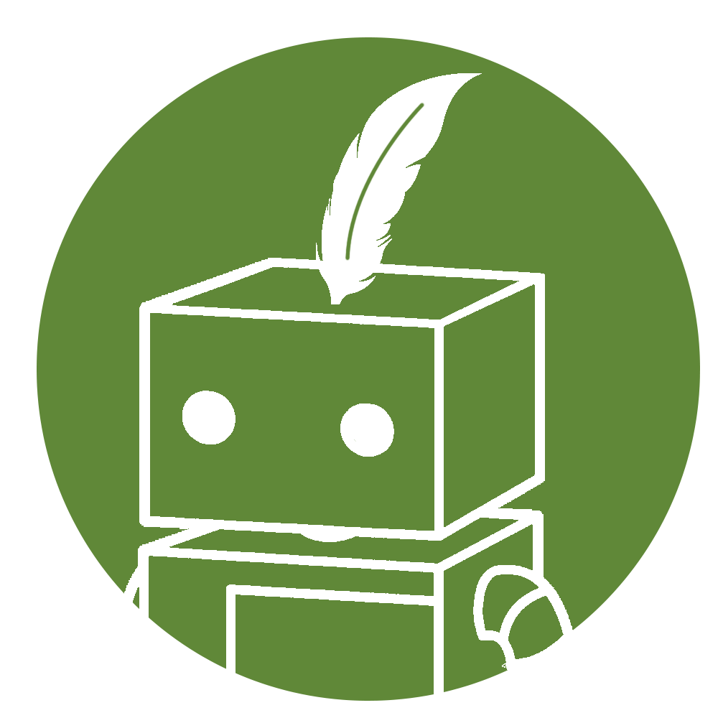
Similar application: Quillbot
QULLBOT:
Quillbot only rephrase it for writing purpose
Quillbot makes the sentence appears more professional.
ROOK:
Rook rephrase it for reading purpose
Rook makes the sentence easier to understand
Rook helps reader with comprehension.

Slide 6
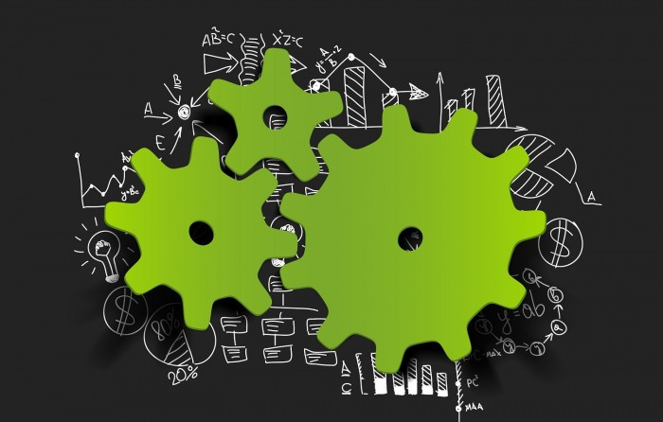
Technical requirements
A team of experts in developing software
A team of linguists

